Slide 1
Algorithm to quickly reject unphysiological virtual patient by exploiting parameter time-constant impact on observations.
Thibaud Derippe – Sylvain Fouliard – Donald E. Mager
CentEx Drug Safety & Pharmacokinetics
Early Phase PK/PD Modeling

Slide 2
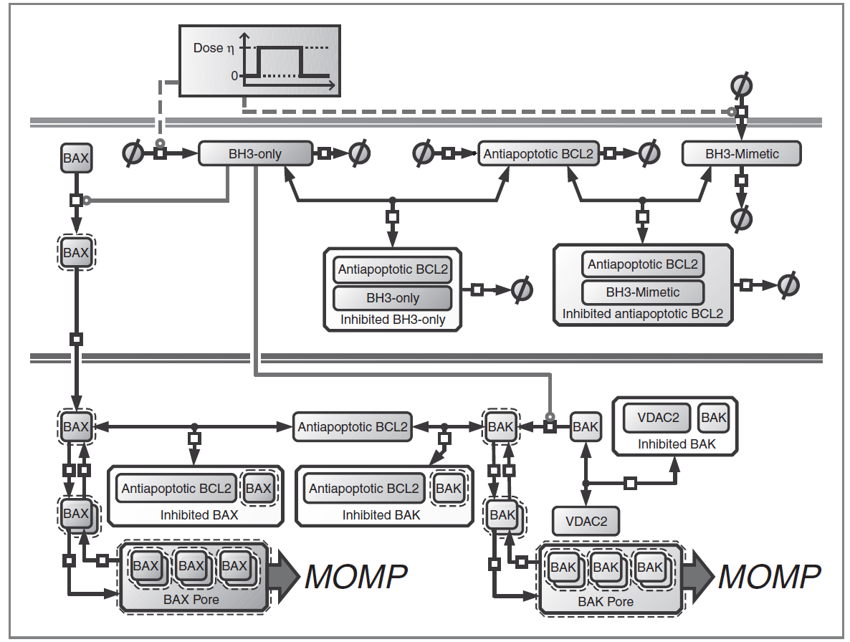
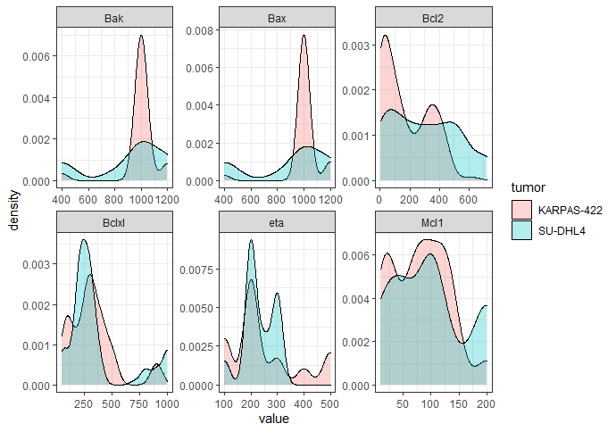
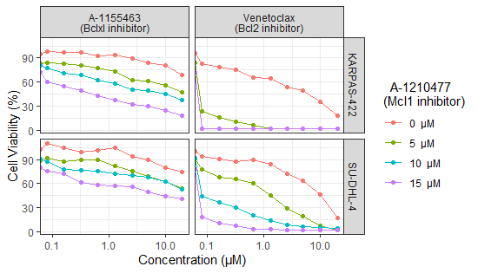
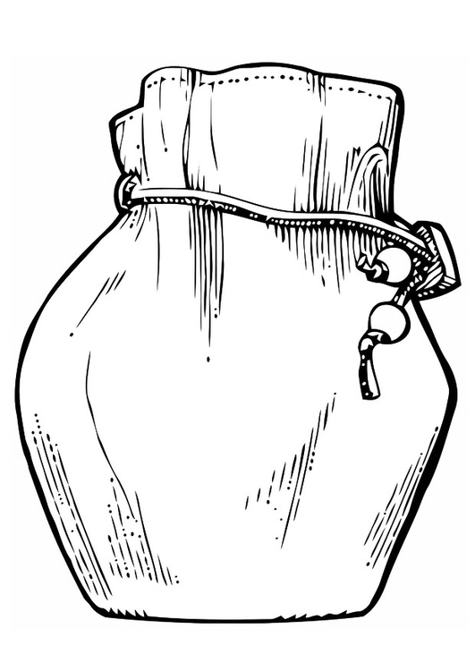
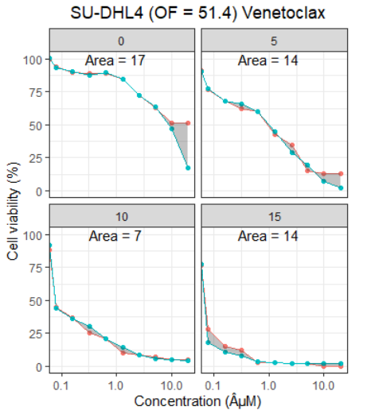
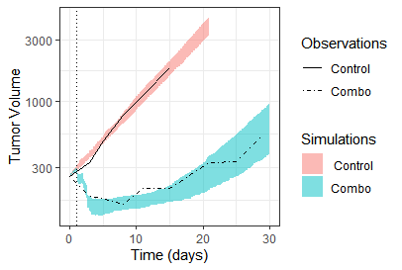
QSP
Celltheques formation
Virtual tumor analysis
Bcl2 * Bclxl * Mcl1 * Bim * Puma * Noxa = 300 000 cells
For each cells, 76 QSP results (from in vitro plot)
In vitro data
Virtual tumor calibration
In vivo data extrapolation
Virtual
Tumor

Slide 3
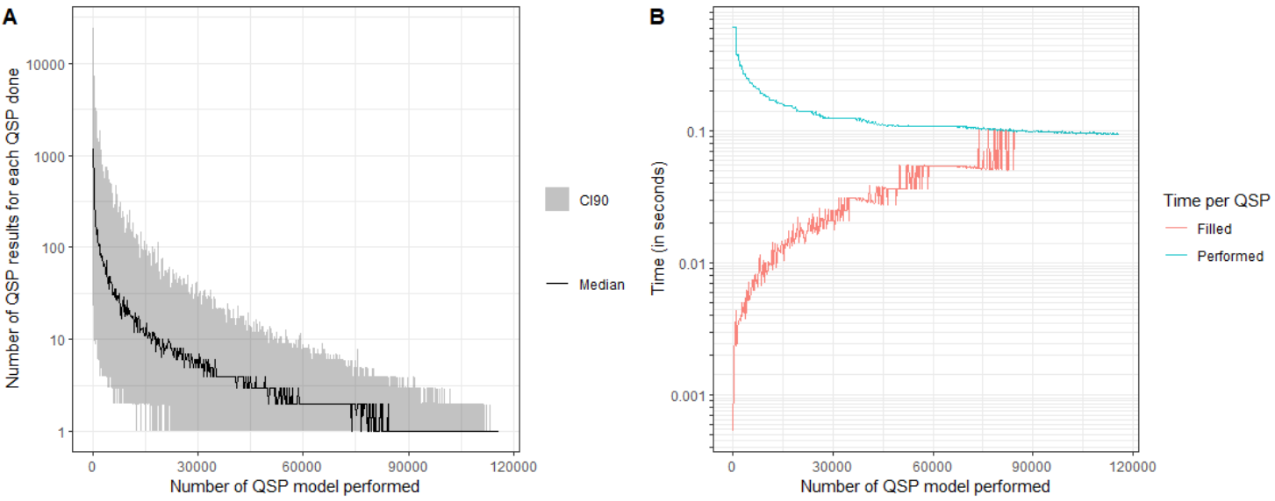
Death and survival agents system: results
« Only » 116.140 QSP really done (vs 4M) -> 35 less QSP done
Total time = 5 hours vs 5 days -> time reduced by 24
Number of QSP « filled » by QSP done
Time per QSP filled and performed

Slide 4
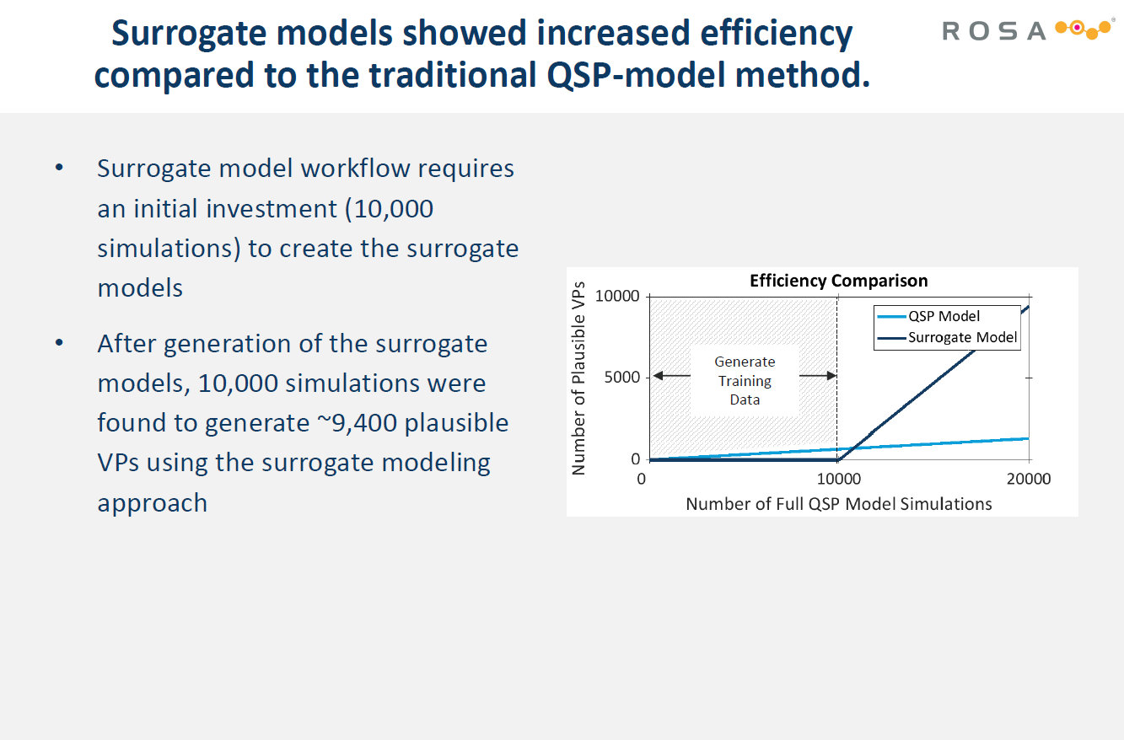
Can we improve that without surrogate ?

Slide 5
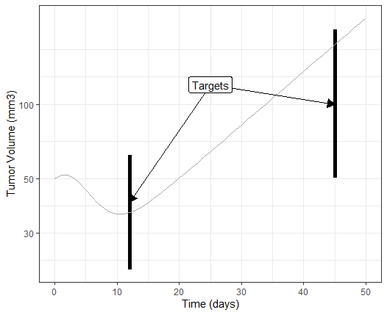
VP acceptation
A VP is accepted only if all its profiles are inside all the target windows

Slide 6
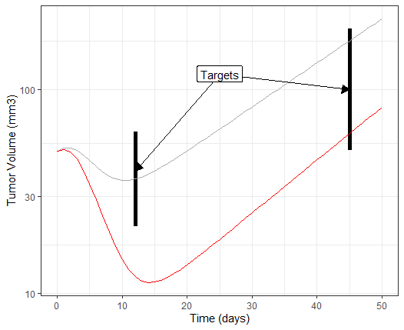
VP rejection after RxODE
A VP is rejected if one of his profile is below and / or above any target
$$VPref → k_{2}=2 ; λ_{0}=0.06 {;λ}_{1}=12 ;k1=0.5 ; ke=1 ;Vd=40$$

Slide 7
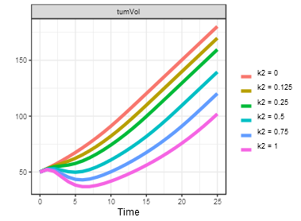
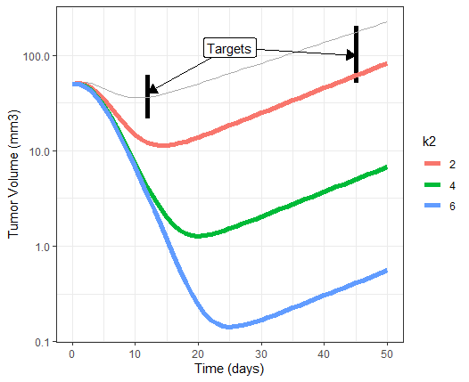
VP rejection after RxODE
K2 impact on tumor volume dynamic
Every VPs with same parameter values but higher k2 also rejected
$$VP_{ref} → k_{2}=2 ; λ_{0}=0.06 {;λ}_{1}=12 ;k1=0.5 ; ke=1 ;Vd=40$$
$$VP_{extr} → k_{2}≥2 \& λ_{0}=0.06 {\& λ}_{1}=12 \& k1=0.5 \& ke=1 \& Vd=40$$

Slide 8
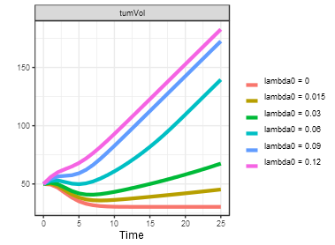
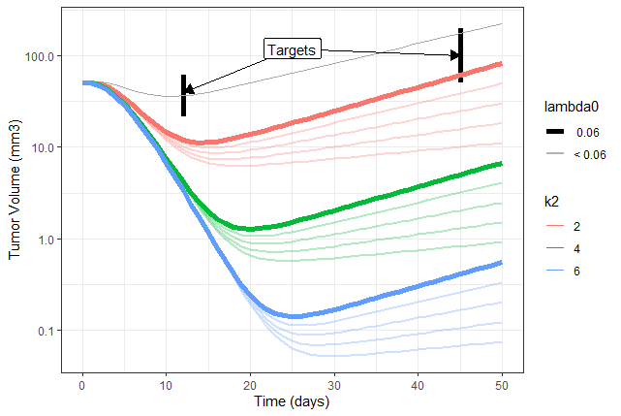
VP rejection after RxODE
lambda0 impact on tumor volume dynamic
Every VPs with same parameter values but higher k2 and /or lower lambda0 also rejected
$$VP_{ref} → k_{2}=2 ; λ_{0}=0.06 {;λ}_{1}=12 ;k1=0.5 ; ke=1 ;Vd=40$$
$$VP_{extr} → k_{2}≥2 \& λ_{0}≤0.06 {\& λ}_{1}=12 \& k1=0.5 \& ke=1 \& Vd=40$$

Slide 9
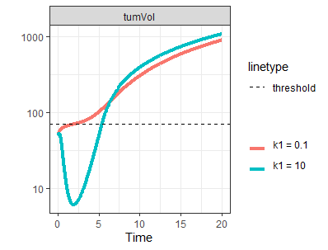
VP rejection after RxODE
k1 impact on tumor volume dynamic
K1 impact on the output is time dependent
$$VP_{ref} → k_{2}=2 ; λ_{0}=0.06 {;λ}_{1}=12 ;k1=0.5 ; ke=1 ;Vd=40$$
$$VP_{extr} → k_{2}≥2 \& λ_{0}≤0.06 {\& λ}_{1}≤12 \& k_{1}=0.5 \& ke≤1 \& Vd≤40$$

Slide 10
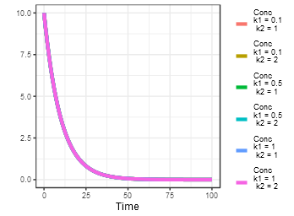
K2 decreasing TV
Four types of parameter
Lambda0 increasing TV
K1 time dependant on TV
K1 not impacting drug concentration

Slide 11
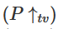
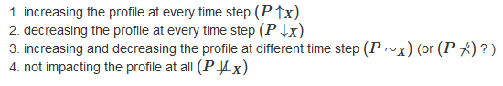
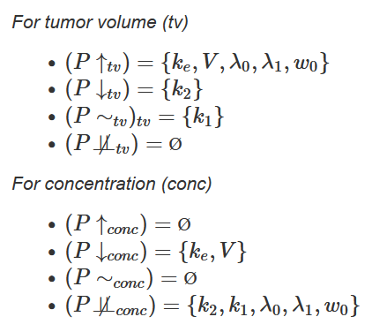
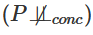
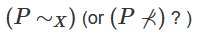
K2 decreasing TV
Four types of parameter
Lambda0 increasing TV
Notation???
K1 time dependant on TV
K1 not impacting drug concentration

Slide 12
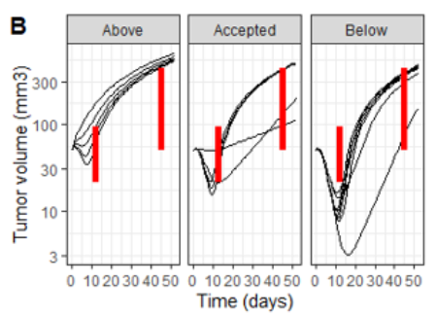
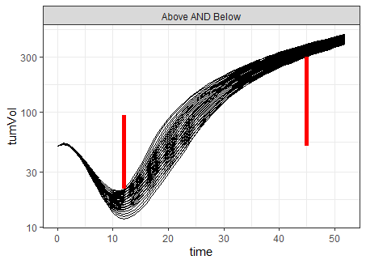
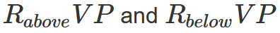
VP status
….

Slide 13
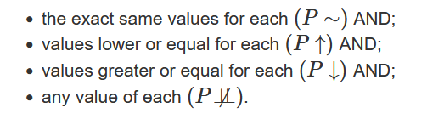
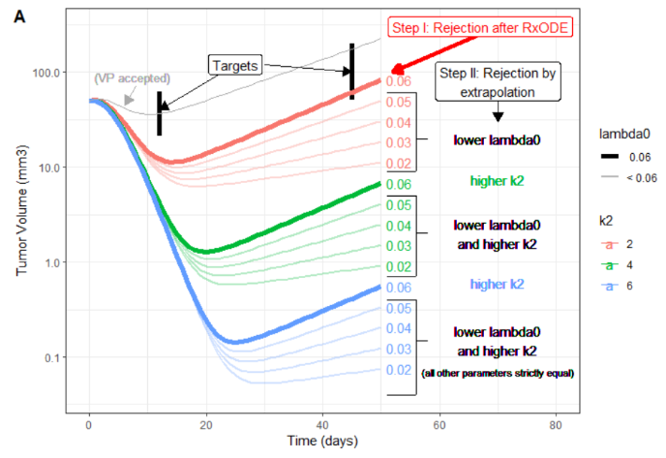
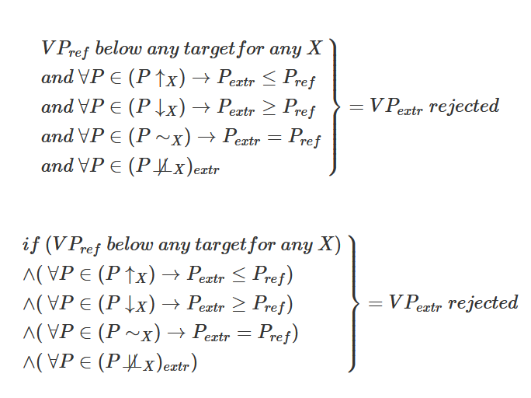
For each RbelowVP for a determine output, it is possible to extrapolate rejection for all patients reaching all this criteria simultaneously:
Text or equation?

Slide 14
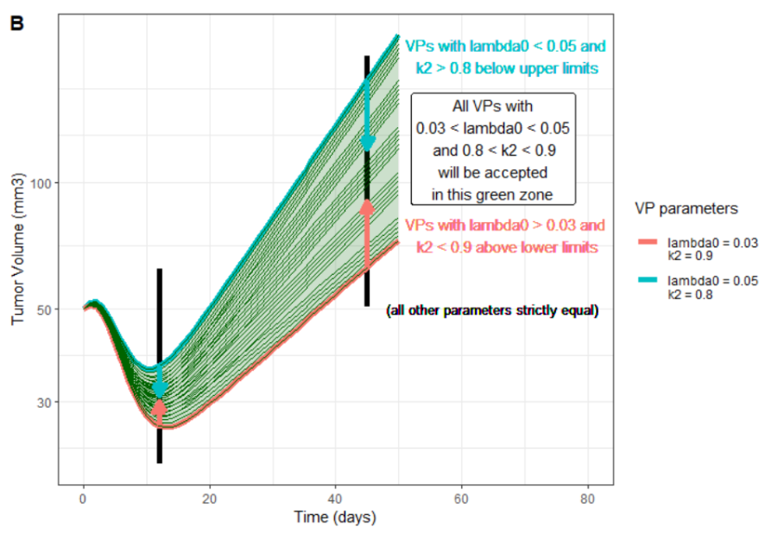
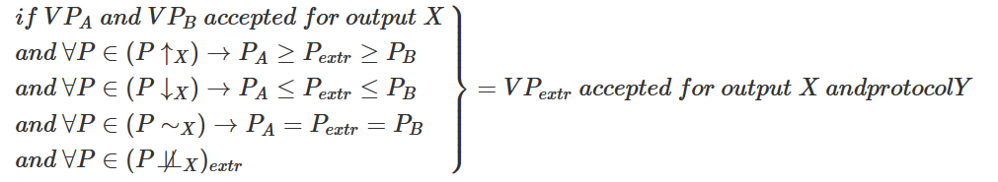
Extrapolate patient acceptation
And protocol Y

Slide 15
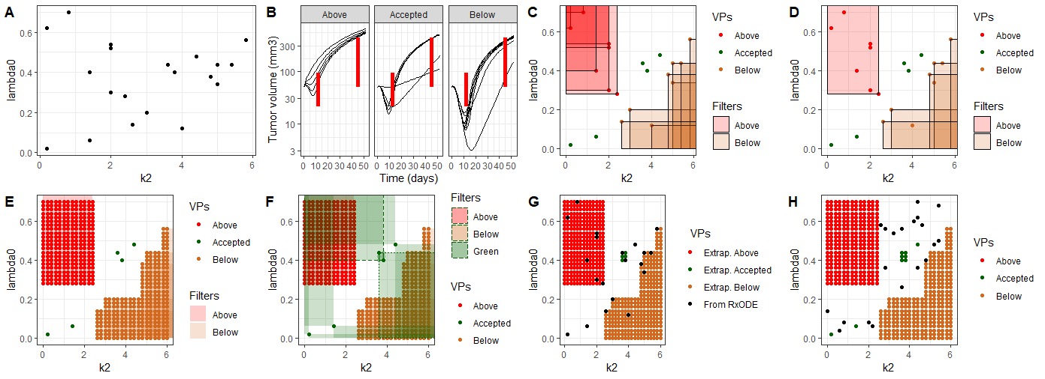
Can I use the terms « Red » and « Green » filters?
$$VP_{extr} → k_{2}≥2 \& λ_{0}≤0.06 {\& λ}_{1}≤12 \& k_{1}=0.5 \& ke≤1 \& Vd≤40$$

Slide 16
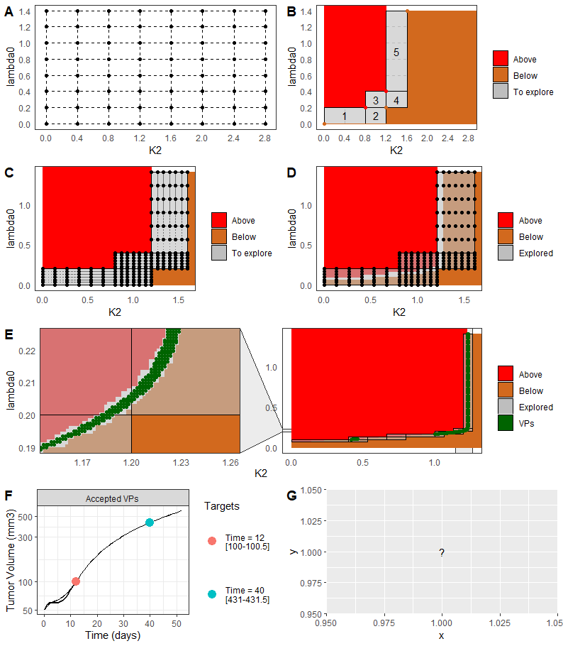
Zone of rejection ?
Zone of uncertainty / maybe-zone ?
Zone of certainty ?

Slide 17
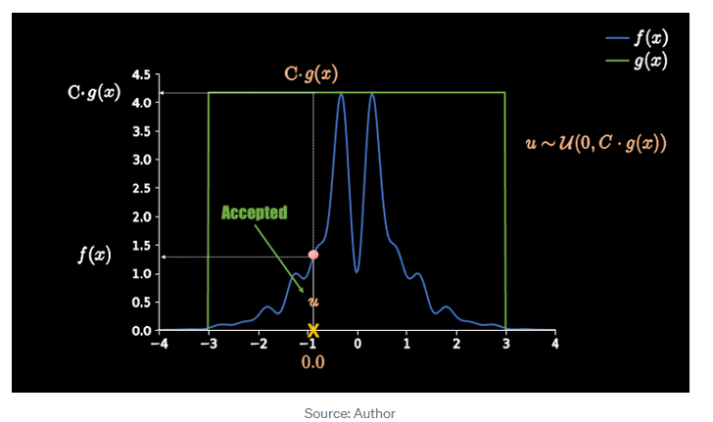
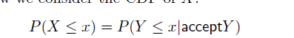
Rejection sampling
https://towardsdatascience.com/what-is-rejection-sampling-1f6aff92330d
No symbol for acceptation?

Slide 18
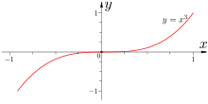
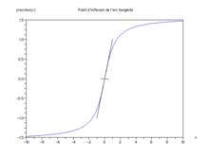
Inflexion point

Slide 19
Mapping

Slide 20
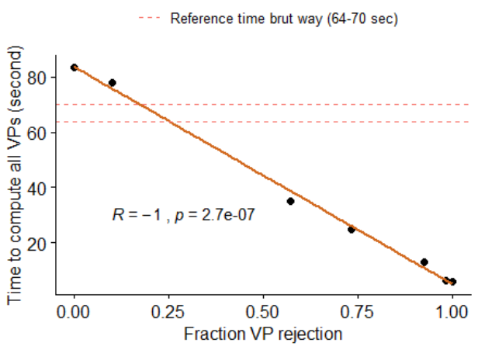
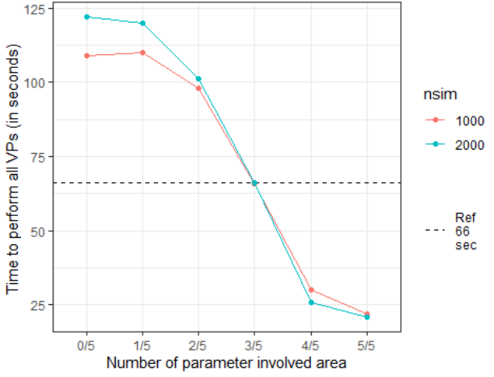
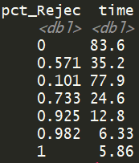
What greatly influence the speed of the system / when to use the algorithm ?
Time computation vs fraction VP rejection
Time computation vs number parameter involved
Max = 83 sec, min = 5.8 sec
Max = 122 sec, min = 22 sec
144/group = 0,0432 sec
Saved….
12/group = 0,0036 sec
Saved….
208.055 VP
Simeoni model
1 YTYPE (tumVol)
1 time window
Two param
(impact more?)
248.832 VP
Simeoni model
1 YTYPE (tumVol)
1 time window
4489 good VP = 18%
Explenation: red filter is always used once more than optimal, but here it take one minutes at 0/5 just for finding no additional rejection, then do everything « manually »

Slide 21
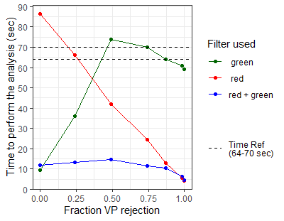
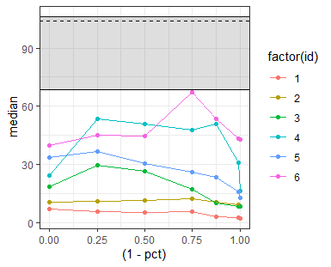

Slide 22
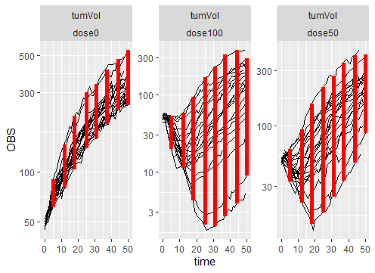
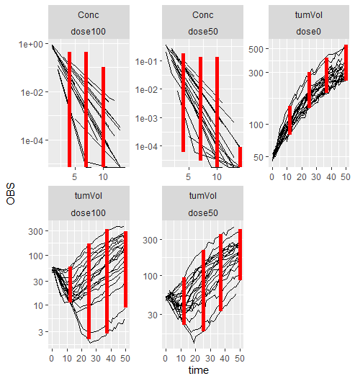
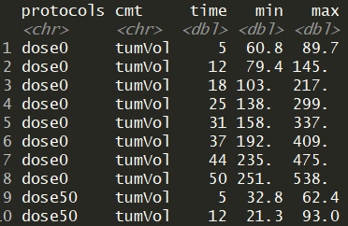
A function take the data, cut the time in inputed number of time for computing accepted windows
Exemple 8 time windows for PD
Exemple 3 time windows for PK and PD
Of course it can be modified
Manually !

Slide 23
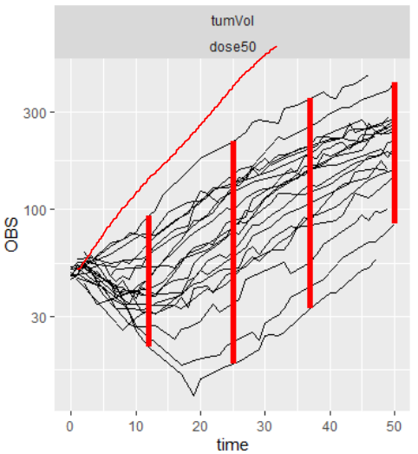
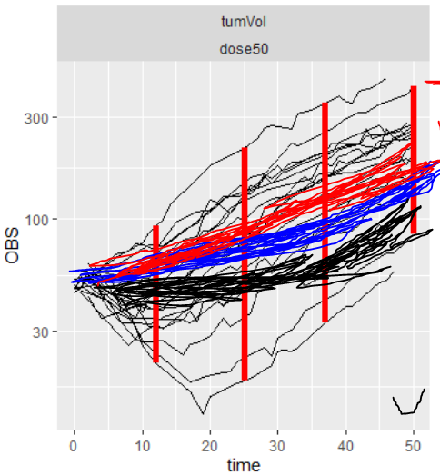
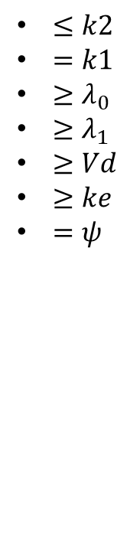
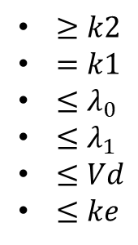
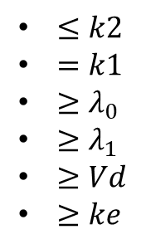
Key mechanism = parameter with predictible impact
k2
lambda0
 | PK (monocomp) | PD (Simeoni)
Param_reduce | Vd, ke | K2
Param_increase |  | Lambda0,lambda1, Vd, ke
Param_no_impact | Lambda0,lambda1, k2, k1
Draw a QSP model
Refused VP because
Accepted (red and blue)
Below
Above
Imagine a VP (blue in plot) with following relative parameters
(same opposite sign)
If he is above, then also remove VP with relative parameters:
Vs res
Vs black
$≤k2$
$=k1$
$≥λ_{0}$
$≥λ_{1}$
$≥Vd$
$≥ke$
$≥k2$
$=k1$
$≤λ_{0}$
$≤λ_{1}$
$≤Vd$
$≤ke$
$≤k2$
$=k1$
$≥λ_{0}$
$≥λ_{1}$
$≥Vd$
$≥ke$
$=ψ$
= below
Upper limit
= above
lower limit
(use of AND gates)
VP accepted (for the PD part, same process for each output)

Slide 24
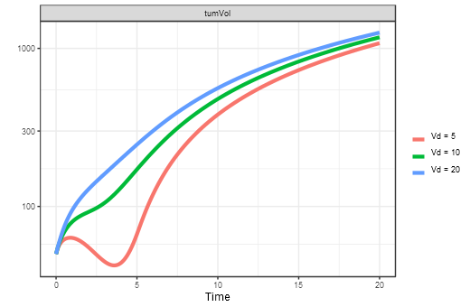
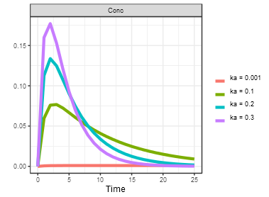

K1 removed
k2
The whole mechanism is dependant on parameters with predictible variation across time
Vd
lambda0
lambda1
Less ffective for parameters like ka
Interest of coding in ke and not Cl for Vd

Slide 25



Data
POC with two compartments (lambda0 and k2)
Step 1: create 176 VP
(Took 1.31 sec)
11 value k2 (from 0 to 20 by 2)
16 values of lambda0 (from 0 to 0,16)
First VP
Step2: analyse res
104 accepted
62 refued

Slide 26




Step 3: use filters for domain of rejections
Aera I am sure VP’s don’t belong
Filter reduction
From now only 8 !
Then, can we capture
The green area?
Plot with 72 filters

Slide 27


Nouveauté faire 1000/2000 qsp simultanément avant d’appliquer la méthodologie
Réduction de filtre avant de les appliquers
Nouvelle algorithme
Draw 2000 VP
Create and reduce neg filter
Apply new filters on the pool of VP
Draw new 2000 VP…
Each model has different optimisation number of simul ?
Make a function to test prior of the QSP VP creations

Slide 28


Red filter need to be disabled when it become cunterproductive
49 sec for 232,470 rows in 5 dim
EQUAL BUT…
Vs 0.35 * 232 / 2 = 40,6 sec
(+ filtering and ordering around 10sec)
For 2000
Can be reduced at 0,5sec
time_compteur
Augmentera avec complexite du modèle /
Nombre d’ODE (x3 lindner?)
Calcul/filtre matricielle pour aller plus vite?
Independant du modèle, mais augmente avec nombre de dimension + param non prédictible
3 sec vs 31 … ☺
puis
46 sec vs 9 …. ☹
12 sec
Score
Theorique?
Donc ALTERNER LES DEUX METHODES
DESACTIVER LES FILTRES DES QUE PLUS RENTABLE (assez tôt apparemment)

Slide 29
Single vs multiple time points

Slide 30




With single time points, VP are either in target, strictly above or stritcly below: no filters superposition

Slide 31




When multiple time points, addition of above AND below rejected VP leads to rejection filter crossing
Prouvable que rejet à l’infini?
+
Filter superposition VP profiles

Slide 32






Single vs multiple YTYPE
PK
PD
PKPD
Can be reduce… but is it computationally worth?
Here not reduce because above and below altogether
Need a mix between them when several YTYPE…

Slide 33
Green filter (currently disabled)

Slide 34



Filtre reduction
In practice not efficient

Slide 35
What impacts the peformances?

Slide 36
What greatly influence the speed of the system / when to use the algorithm ?
Time computation vs fraction VP rejection
Time computation vs number parameter involved
Max = 83 sec, min = 5.8 sec
Max = 122 sec, min = 22 sec
144/group = 0,0432 sec
Saved….
12/group = 0,0036 sec
Saved….
208.055 VP
Simeoni model
1 YTYPE (tumVol)
1 time window
Two param
(impact more?)
248.832 VP
Simeoni model
1 YTYPE (tumVol)
1 time window
4489 good VP = 18%
Explenation: red filter is always used once more than optimal, but here it take one minutes at 0/5 just for finding no additional rejection, then do everything « manually »

Slide 37
Localisation of rare virtual patients

Slide 38






+
For each square
See if involved in
filter

Slide 39

Color area become the new grid with much smaller step
After a second turn and finding thousands of VP!

Slide 40




Algorithm under construction
Divide the space into aroud 200K VP
Give a domain with minimal step
$$ncut=\sqrt[{(n}_{param}) 6]{200.000}≈8$$
(in 6
dimension)
Let’s zooooooooom
Use the algorithm to determine zone to look at
No
Can a zone be divided in 200.000VP with minimal step?
Yes
Explore completely the zone

Slide 41
Etude param utilisable

Slide 42







Only difference = kint

Slide 43
Sequestration
A
k12
B
k21
ke

Slide 44

Administration
A
ka
B
ka

Slide 45


Homeostasie
IRM
kout
IRM2
kin
kout2

Slide 46


Homeostasie decrease kin
IRM
kout
IRM2
Kin * (1 – EMAX)
kdeg
Similar increase kin

Slide 47


Elimination dans le sdeux
k12
A
B
k21
Si ke > ke2
only
ke
ke2
(Si faible alors effet séquestration)
(si élevé alors effet élimination)
(ke == ke2, parallel)

Slide 48
Only difference = kint

Slide 49
Elimination dans le sdeux
A
B
(Si faible alors effet séquestration)
(si élevé alors effet élimination)

Slide 50
Backup

Slide 51



Step 4: use filters for domain of acceptations
Now, need an algorithm to complete the white area

Slide 52

Small differences due to initial random sampling and patient remove for above or below while in fact both

Slide 53





Slide 54


Is k1 a reducer of an alterner ?
If only exp when k1 increaes -> always reduced
If only linear when k1 increaes -> always reduced

Slide 55


But ALTERNER
If using the Simeoni equation
$$λ_{0} ⋅X1$$
$$λ_{1} ⋅\frac{X1}{Wt}=λ_{1}⋅pctProlif$$

Slide 56


Slide 57
Digital twins

